Slide 1
Extending SharePoint with Application Pages and Custom Web Services
© 2007 Alexander Pajer

Slide 2
Implementing Custom Web Services
Extending SharePoint Menues with Application Pages

Slide 3
SharePoint WebServices

Slide 4
Why use SharePoint WebServices?
SharePoints Object Model can only be used on the local server
In order to use you custom solutions from a remote machine you have to use implement a WebService
SharePoint provides several „out-of-the-box“ WebServices

Slide 5
WebServices provided
A complete list of available list is pulished in the SDK
WebService | Usage
Administration WebService | Administer site collections
Alerts WebService | Manage alerts
Lists WebService | Manage lists
Permission WebService | Manage permissions
Search WebService | Query site and list data
Users and Groups WebService | Manage users and groups
Web Part Pages WebService | Manage WebParts
Workflow WebService | Manage Workflows
Webs | Get Metadata about Site Collections

Slide 6
Consuming a built-in WebService
//using SharePoints "webs.asmx" ws to get a list of webs in the site collection
Webs webssrv = new Webs();
webssrv.Credentials = CredentialCache.DefaultCredentials;
XmlNode node = webssrv.GetAllSubWebCollection();
//this is what you get
string strWebs = node.OuterXml;
foreach (XmlNode cn in node.ChildNodes)
{cbSite.Items.Add(cn.Attributes.GetNamedItem("Title").Value);}

Slide 7
Create a Custom SharePoint WS
Implement and test the WebService
If you are using custom types as parameter serialize /deserialize them
Test on a development site host
Deploy to SharePoint
MSDN - „Writing Custom WebServices“
http://msdn2.microsoft.com/en-us/library/ms464040.aspx

Slide 8
Demo
Using the Alerts WebService
Creating a custom SharePoint WebService

Slide 9
Extending the User Interface

Slide 10
Extending the User Interface
Extensible Toolbars, Menus, Settings Pages
Link to Application Pages
Can use ASP.NET controls on toolbars
Associate by
List type
Content type
File Type

Slide 11
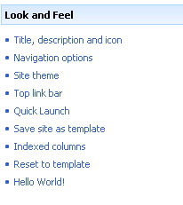
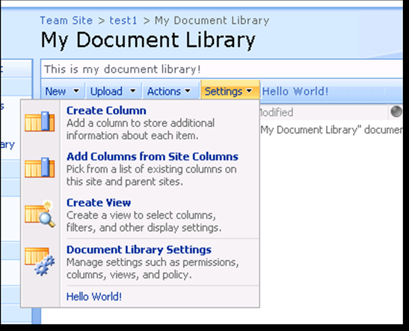
Extending the User Interface
List Toolbar & Drop-Down Menus
Site Settings

Slide 12
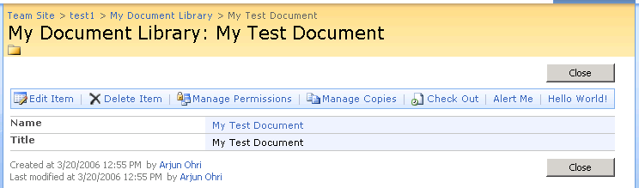
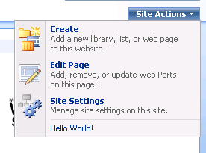
Extending The User Interface Cont
Form View Toolbar
Site Actions

Slide 13
Custom Site Settings
<?xml version="1.0" encoding="utf-8" ?>
<Elements xmlns="http://schemas.microsoft.com/SharePoint/">
<Module Name="Favorites Manager Settings Page" Path="" Url="">
<File Url="favorites.aspx" Type="Ghostable" IgnoreIfAlreadyExists="FALSE" />
</Module>
<CustomActionGroup Id="CustomSiteSettingsGroup" Location="Microsoft.SharePoint.SiteSettings" Title="Favorites Manager" Sequence="100" Description="" />
<CustomAction Id="Favorites Settings" GroupId="CustomSiteSettingsGroup" Location="Microsoft.SharePoint.SiteSettings" Sequence="10" Title="...">
<UrlAction Url="~site/_layouts/FavoritesManager/favorites.aspx" />
</CustomAction>
</Elements>
Notes:
Developing SharePoint Wrox p150

Slide 14
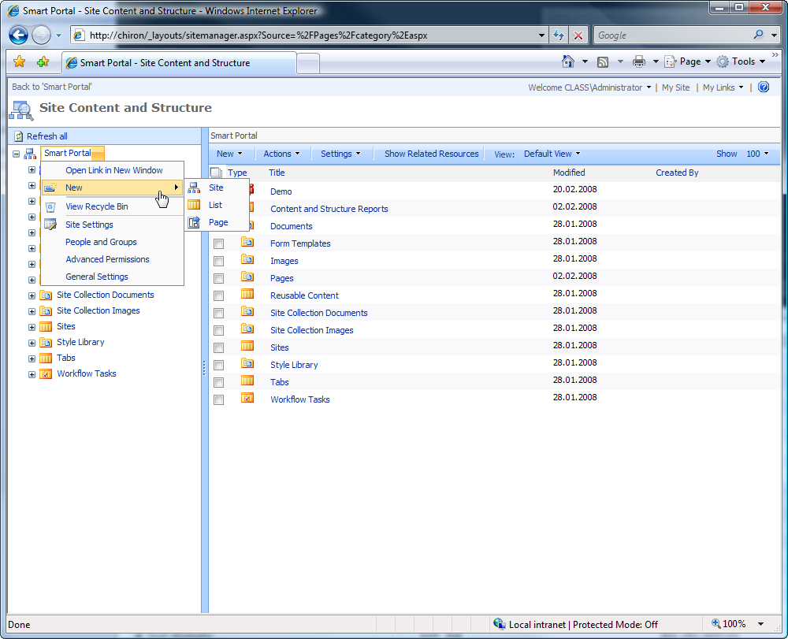
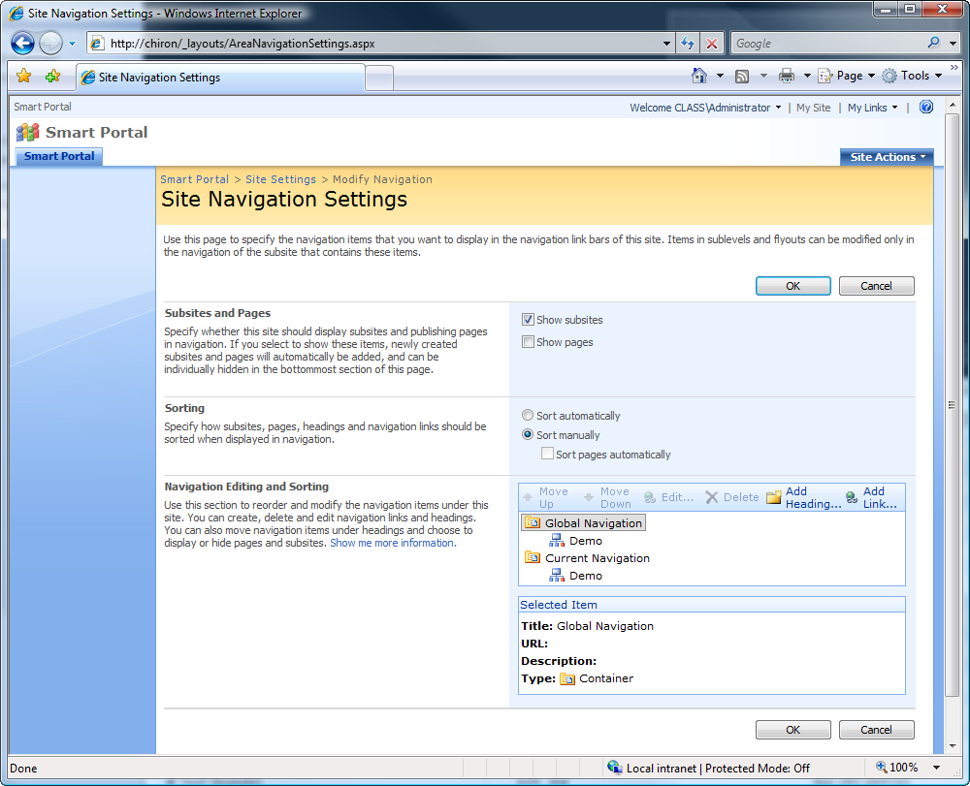
Application Page - Samples

Slide 15
Application Pages
Stored in ..\Template\Layouts
Are used to implement extentions to functionality and are often extend the menus
May contain
INLINE CODE or
Refernce assemblies deployed to GAC.

Slide 16
Components of Application Pages
Application pages consist of:
ASPX – Layout of the controls
Assembly implementing the Code Behind Class

Slide 17
Application Page - ASPX
Stored in /Layouts/Featurename/
<%@ Assembly Name="Microsoft.SharePoint, Version=12.0.0.0, Culture=neutral, PublicKeyToken=71e9bce111e9429c" %>
<%@ Assembly Name="CopyToFeature, Version=1.0.0.0, Culture=neutral, PublicKeyToken=b8c1e1a21841a588" %>
<%@ Page Language="C#" MasterPageFile="~/_layouts/application.master"
Inherits="Integrations.CopyTo” EnableViewState="true" EnableViewStateMac="false" %>
<%@ Register TagPrefix="SharePoint" Namespace="Microsoft.SharePoint.WebControls“
Assembly="Microsoft.SharePoint, Version=12.0.0.0, Culture=neutral, PublicKeyToken=71e9bce111e9429c" %>
<%@ Register TagPrefix="Utilities" Namespace="Microsoft.SharePoint.Utilities" Assembly="Microsoft.SharePoint, Version=12.0.0.0, Culture=neutral, PublicKeyToken=71e9bce111e9429c" %>
<asp:Content ID="Main" ContentPlaceHolderID="PlaceHolderMain" runat="server">
....
</asp:Content ID>

Slide 18
Application Pages – Code Behind
Classes used to implement Application Pages must inherit from LayoutPageBase
Controls used in ASPX must be declared as protected global variables in Code Behind
Use SharePoint Controls defined in Microsoft.SharePoint.WebControls to have ShrePoint Look & Feel

Slide 19
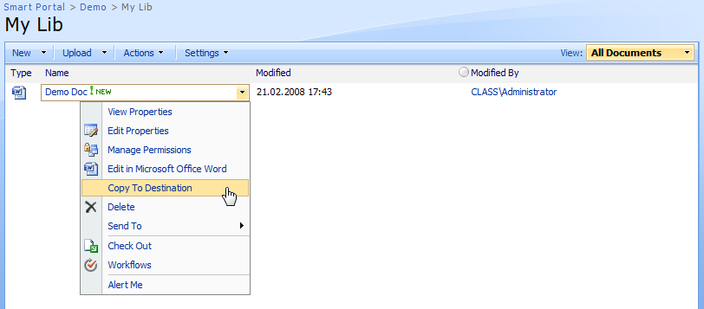
Custom Edit Control Block
<Elements xmlns="http://schemas.microsoft.com/sharepoint/">
<CustomAction Id="Integrations.CopyTo"
RegistrationType="List"
RegistrationId="101"
Location="EditControlBlock"
Sequence="300"
Title="Copy To Destination">
<UrlAction Url="~site/_layouts/CopyTo.aspx?ItemId={ItemId}&amp;ListId={ListId}"/>
</CustomAction>
</Elements>
Notes:
Developing SharePoint Wrox p150

Slide 20
Demo
Implementing a Custom Application Page

Slide 21
THANK YOU!!
ALEXANDER.PAJER@INTEGRATIONS.AT

